Slide 1
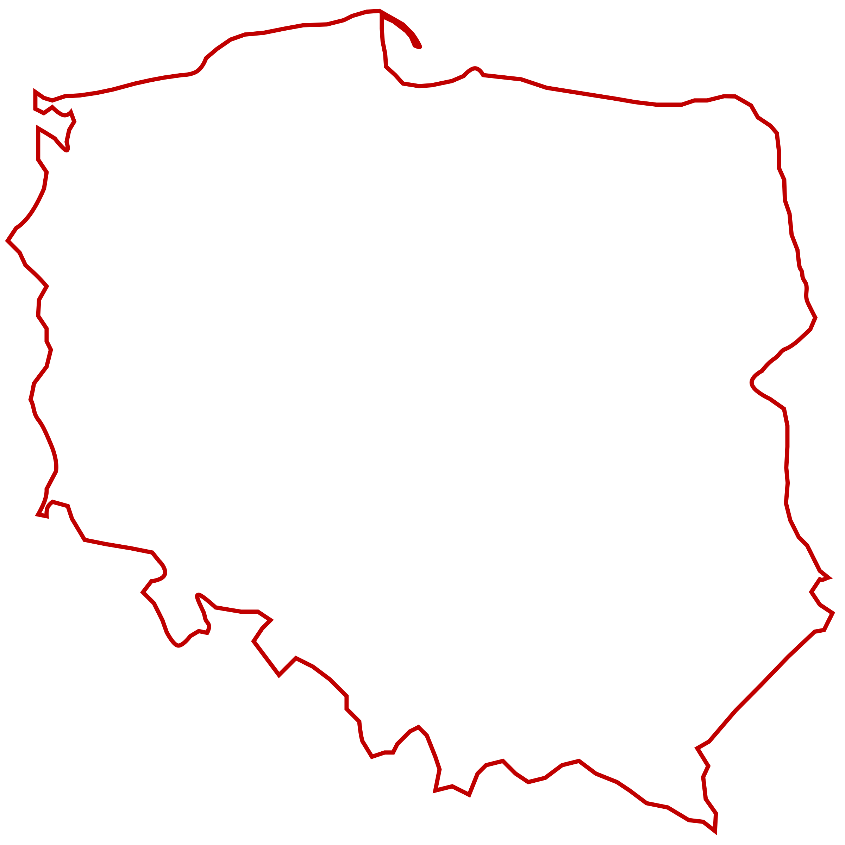

Golang Poland Meetup #6 28 September 2020
Golang Warsaw Meetup #40
GoBridge

Slide 2
Agenda
DIY Gosec: Detect complex code patterns using semantic grep Yoann Padioleau
Your announcements || Engineer lost & found and Grab coffee/beer break [10 min]
Microservices - The End of Software Design Ole Bulbuk

Slide 3
Questions?
Join channel #poland on gophers.slack.com.
https://invite.slack.golangbridge.org

Slide 4
Good Questions/Answer = JetBrain license

Slide 5
Where to find us?
Twitter:
@golangwaw
@CracowGo
Slides: https://github.com/golangpoland/meetup_golang_warsaw

Slide 6
Speakers wanted
Please ask your colleages

Slide 7
Ideas? Shall we do sth different/new?
It is your meetup.

